Slide 1

API Through R
YiLin Liu

Slide 2
Table of Contents
Goal
Overview
Basics
OAuth
Base Packages
Facebook
Facebook API
Rfacebook
Mini-Projects
Twitter
Twitter API-REST
TwitteR
Stream API & StreamR
Flickr
Flickr API
Weather Web Scraping
Others

Slide 3





Goal
Facebook API
Twitter API
Google Maps API
Flickr API
Weather Data
Notes:
Logo credits: respective companies

Slide 4

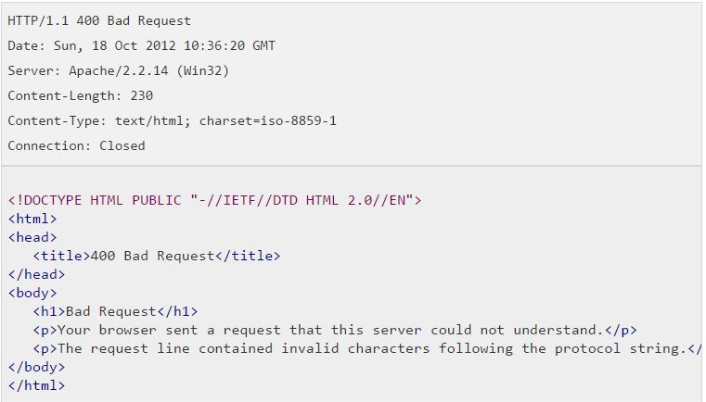
Overview: Basics
All requests are HTTP requests
https://maps.googleapis.com/maps/api/geocode/json?address=Mountain+View,+CA&key=55883441423
Service Endpoint
API Method
Response Format
Method Parameters
Authorization Key
An response will be given to the request
Picture taken from here

Slide 5
Overview: Base Packages
The following packages where often used and encountered:
JSONlite : An R package that handles JSON responses and converts the input into a nested list for parsing.
Xml2: An R package which handles xml documents and allows the extraction of information based on CSS tags.
Httr: The R package which handles internet connection, http methods, Oauth tokens etc.

Slide 6







Google Maps: Maps API
Directions
Distance Matrix
Elevation
Geocoding
Time Zone
Roads
Places

Slide 7

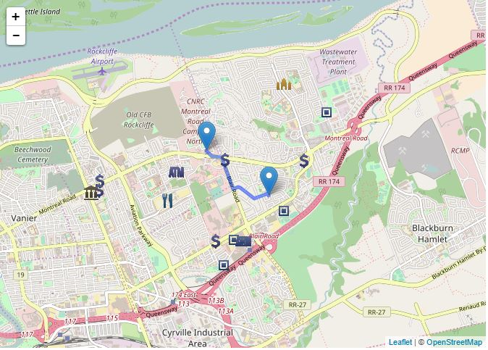
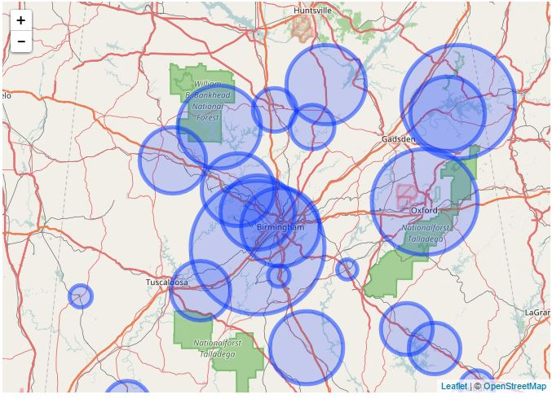
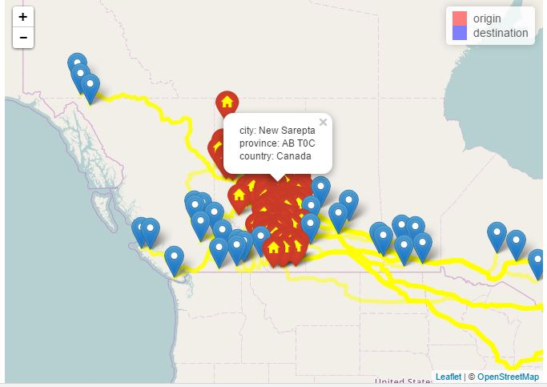
Google Maps:
Directions
Crime Data
Origin/Destination Pairs
Interactive Maps

Slide 8

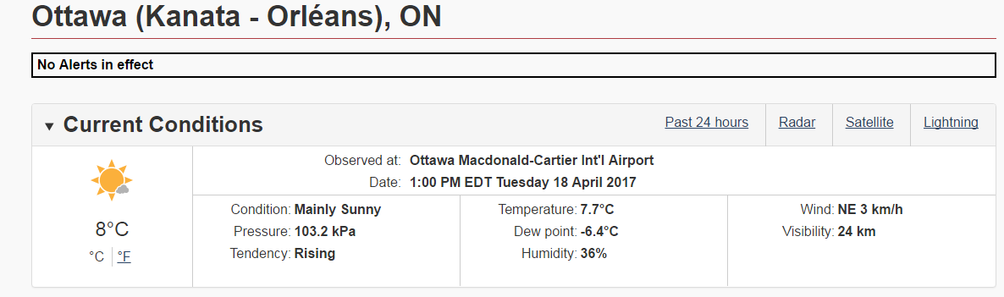
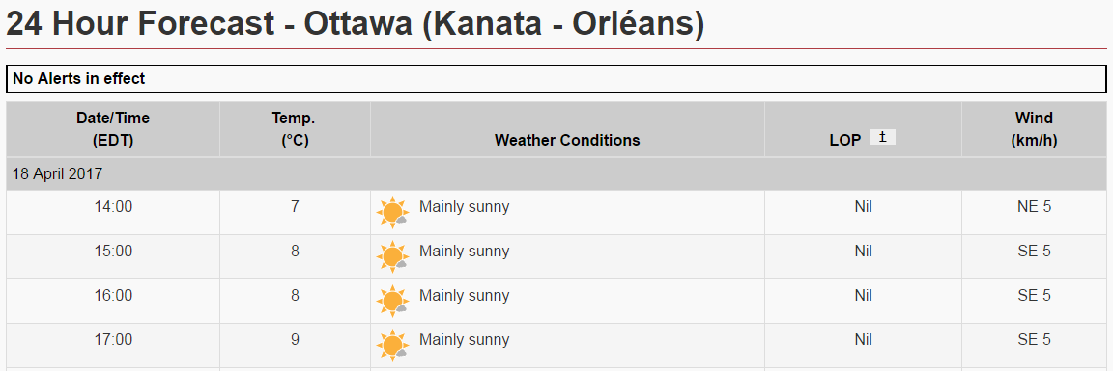
Weather Web Scrapping:
Data Collection
Current Weather
Forecasted Weather
Formatted Data

Slide 9
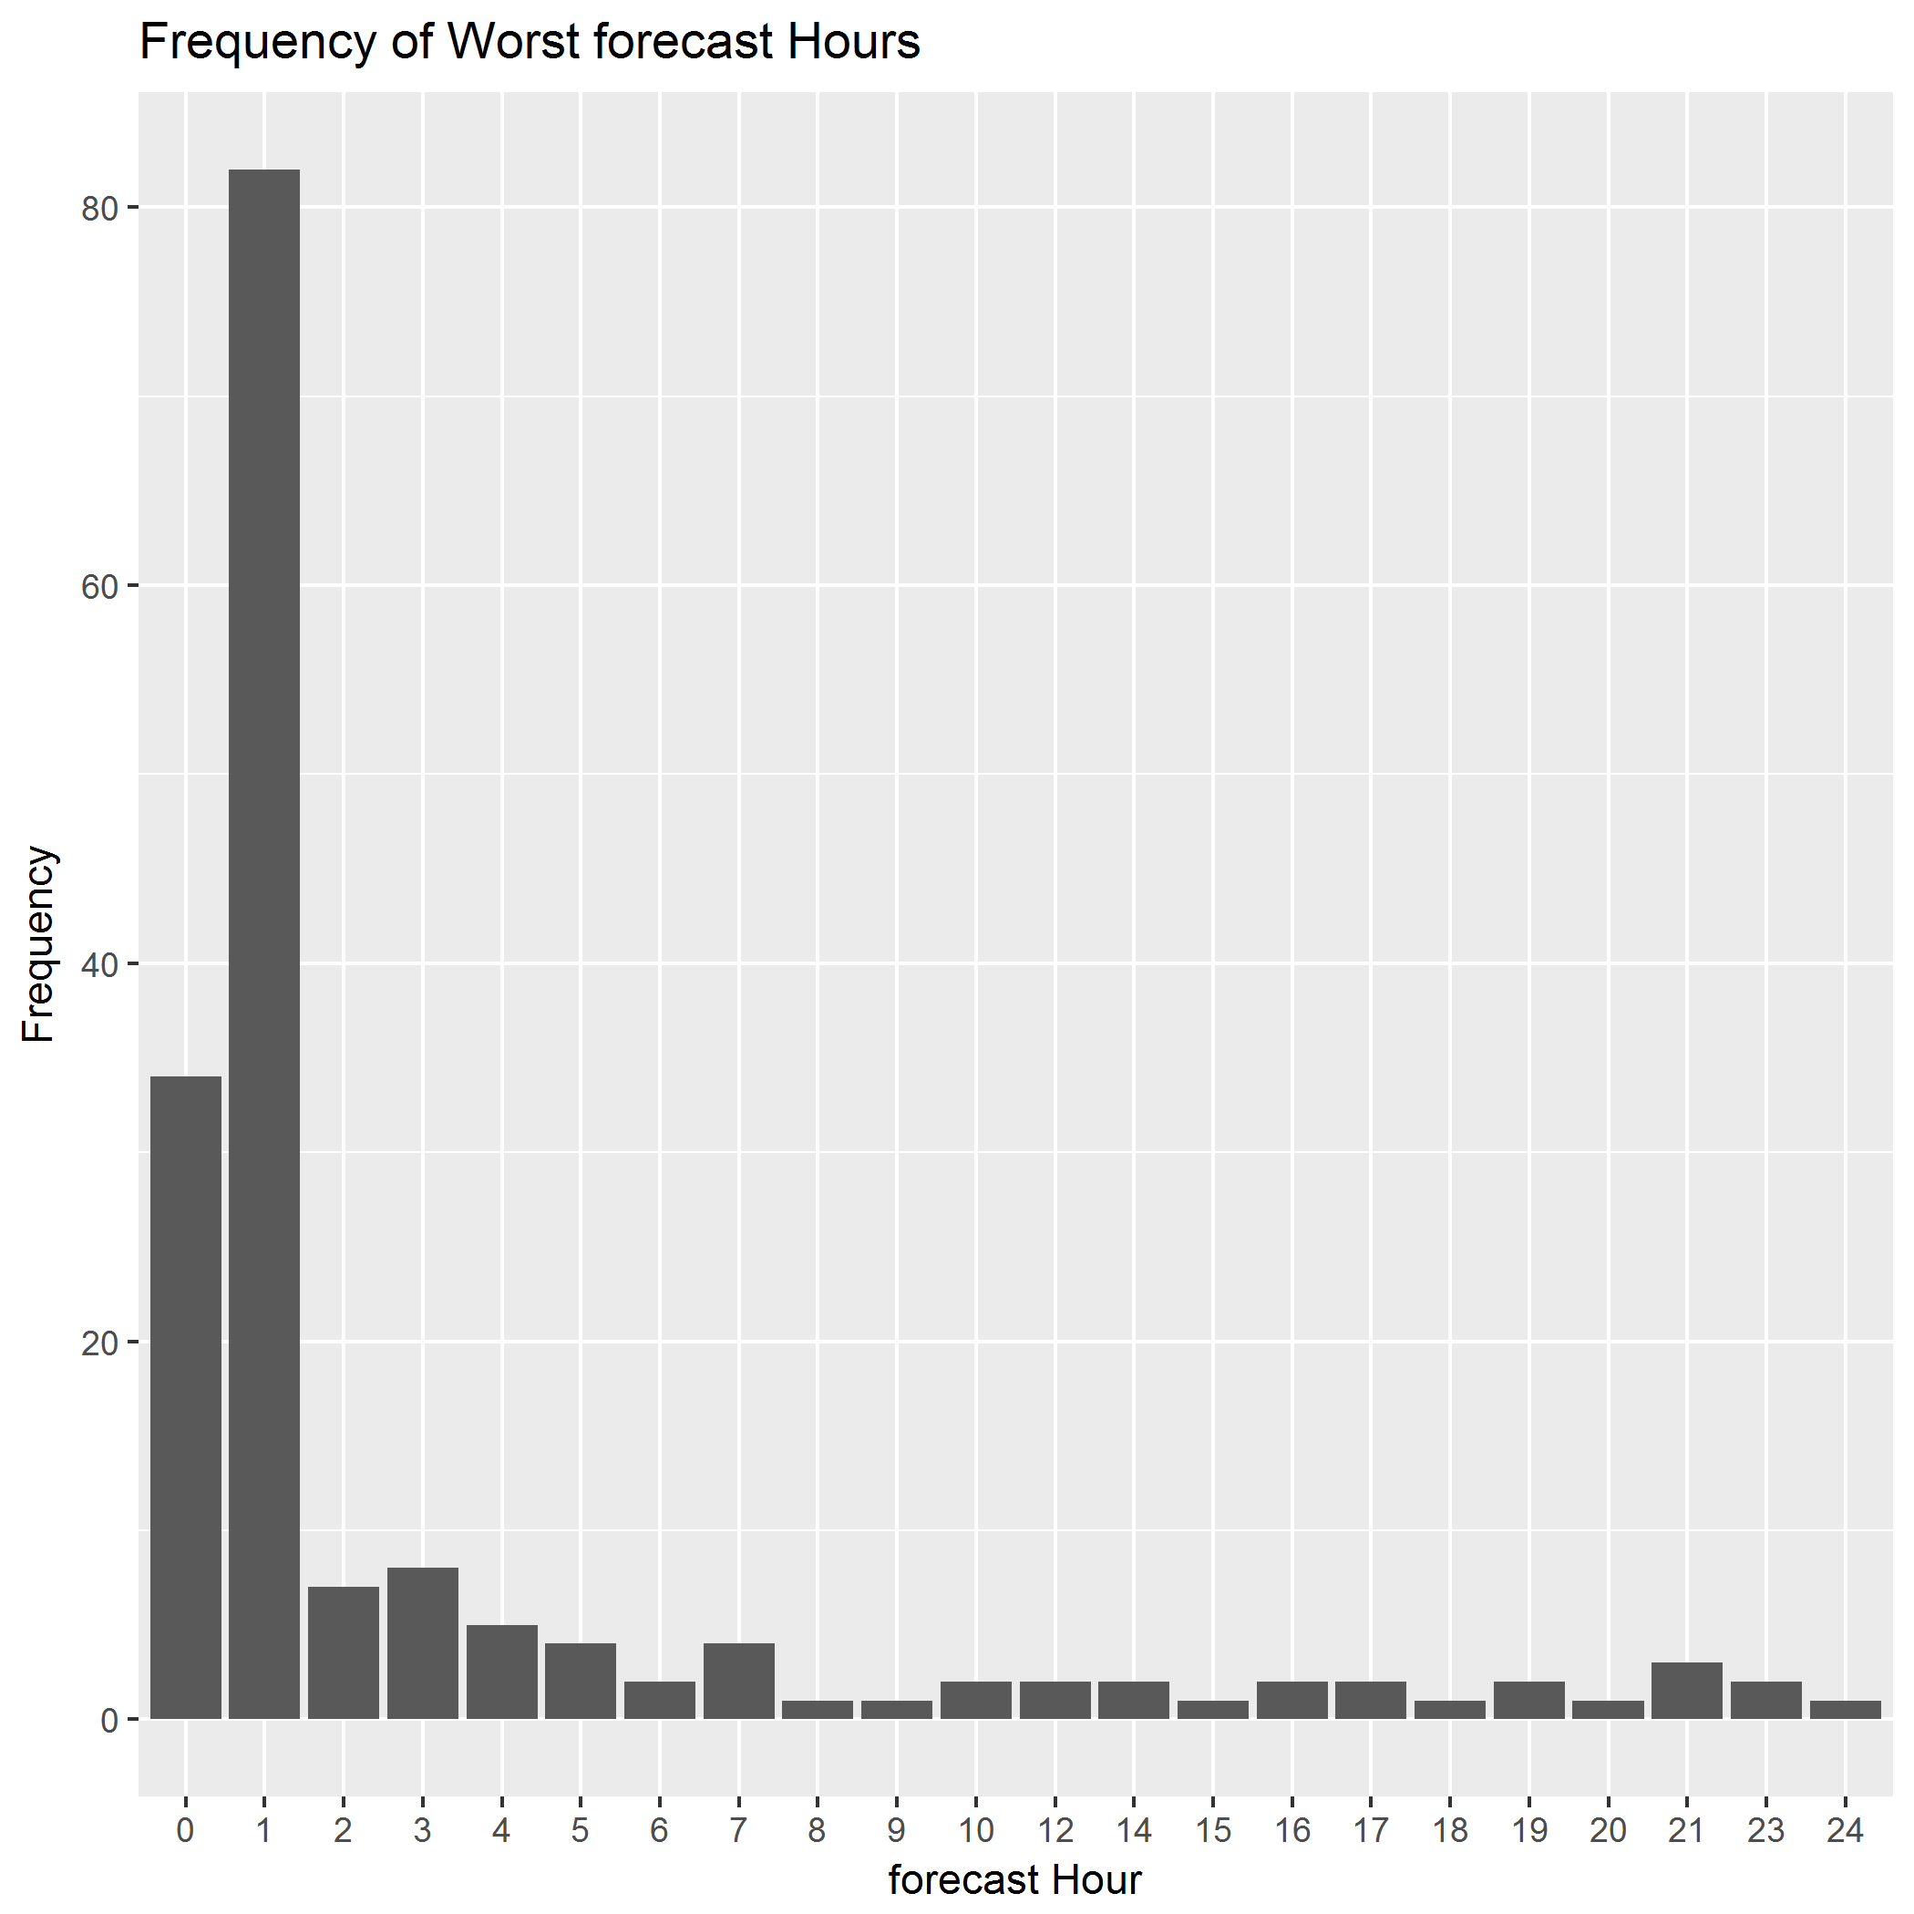
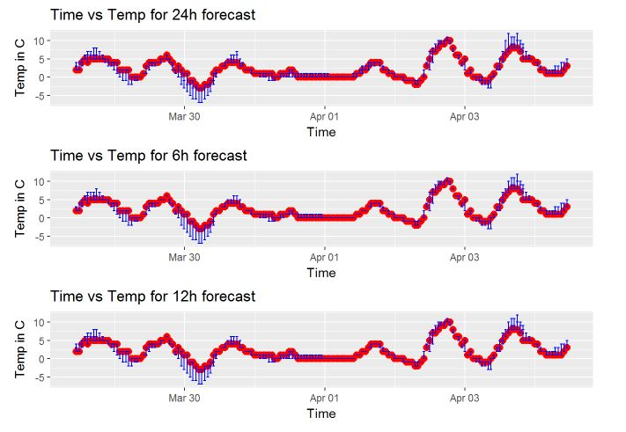
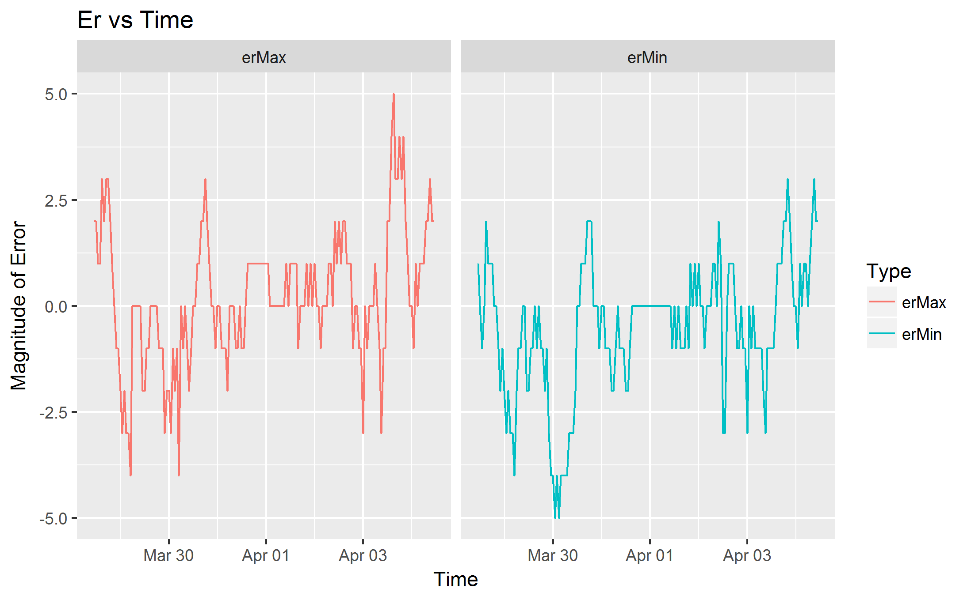
Weather Web Scrapping:
Data Processing
Plot of actual temperature
And predicted temperatures as error bars for various hours of forecast
Plot of the Maximum and Minimum forecasted temperatures’ errors for all 24 hours of forecasted temperature.
Plot of when the worst predicated temperature in terms of how close to actual time was the worst prediction.

Slide 10
Facebook: API
Intro
Advantages
Disadvantages
API is structured as a graph.
Key Components: Nodes, Edges & Fields .
Reference by id mostly.
Results are often paginated.
Rate limit is about 200 calls per user in aggregate for the application. Not all calls are subjected to rate limit.
Uses Oauth protocol and requires the creation of an application.
Does not have commercial version.
Easy to access public data. Posts, groups, comments.
Easy to keep track of conversation via comments and replies to comments.
Due to new update to API, it is no longer possible to access identity information regarding users.
Many end points require use permission, thus it is not publicly available.
Require Id.
Lack of location information.

Slide 11
Facebook: Rfacebook
Advantages
Disadvantages
Public searches of Facebook.
Allows extraction of comments, posts, replies to comments.
Easy to understand source code, provides a framework for general JSON parsing.
Data returned is nicely formatted.
Does not allow custom fields.
Many functions are deprecated due to new updated Facebook API.

Slide 12
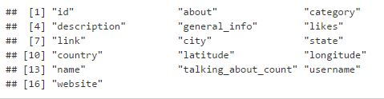

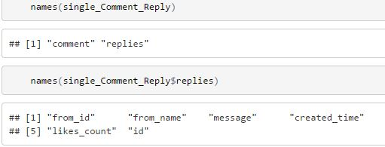

Facebook: Rfacebook
Search via searchPage
Extract posts using getPost
More details
Extract Page information getPage
Extract comment replies getCommentReplies

Slide 13
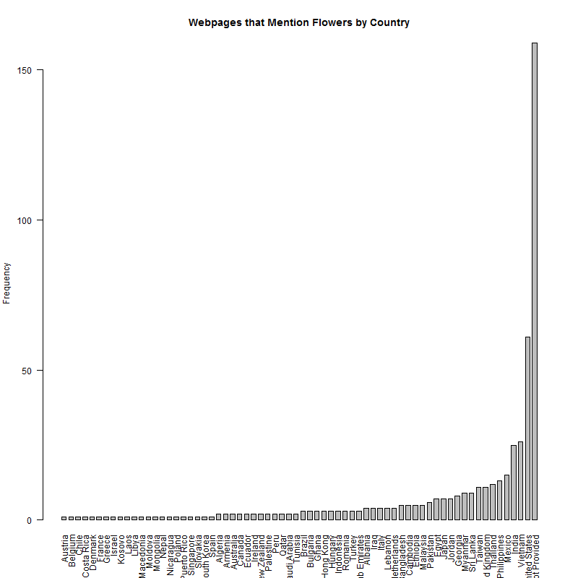
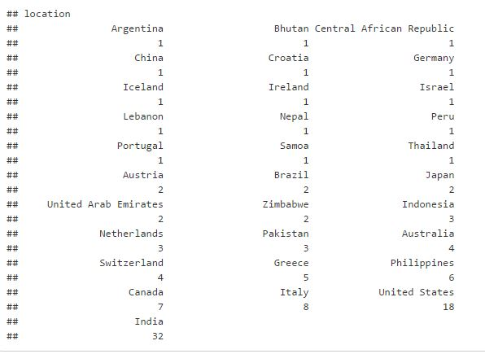
Facebook: Mini-Projects
Page mentioning Flowers
Most visited locations
webpage

Slide 14
Twitter: Twitter API-REST API
Intro
Advantages:
Key Components: Tweets, Users, Entities, Places.
Reference by id and names.
Results are often paginated.
Rate limit is based on 15 minute windows with differing limits for each call.
Uses Oauth protocol and requires the creation of an application.
Does not have commercial version. Include ad APIs.
Include Search API, with powerful query abilities.
Search API is powerful.
User information and tweets are public and readily available most of the time.
User tweets can be historic up to maximum tweet.
Disadvantages:
Search API only recent data(1 week).
Hard to keep track of conversation.

Slide 15
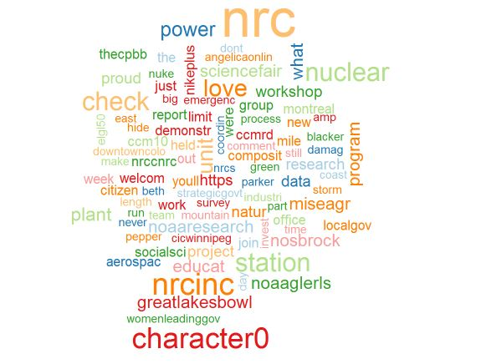
Twitter: RtwitteR
Advantages
Disadvantages
User friendly organization using class wrappers.
Provides basic interface to extract tweets, users and social data.
Allows data base connection
Provides token authorization functions.
Token is cached internally, external methods can not gain access.
Does not specify entities, this can be fixed via custom http requests and then analyzing.
Word Map

Slide 16
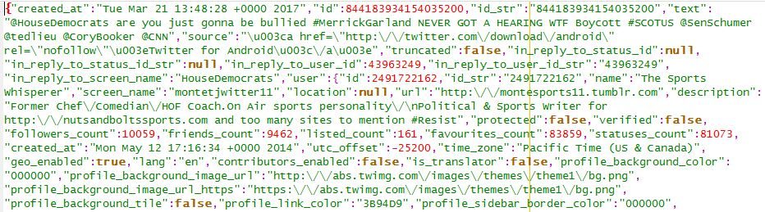
Twitter: Stream API & streamR
Intro
streamR
Stream API is divided into 3 sections:
Public stream: public update of tweets.
User stream: user updates
No rate limit, but will disconnect if errors occur.
Very simple package providing functions to connect to various streams and output the responses to a file.
Stream of CNN Tweets

Slide 17


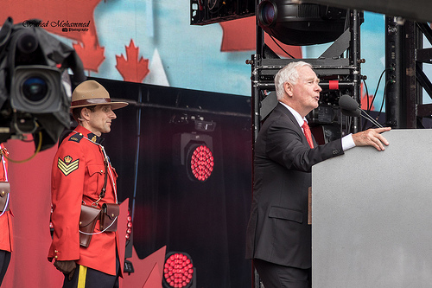
Flickr: Flickr API
Flickr API
Canada Day 2015
Photo sharing/host site.
Standard HTTP request and parse response.
API not supported by official Flickr.
Methods don’t require access token.
Public search function was explored: text and tag searches.
Limited information.
Photo details provided.
Search Response
Photo MetaData
Photo URL

Slide 18
Questions?

Slide 19
Thank You

Slide 20
Others:
Prophet Package
Exif Tool
Cities Project
Pdf Project

Slide 21
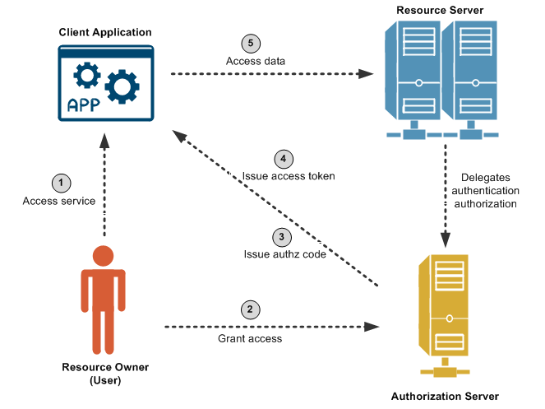
Overview: OAuth
Credit to this page

Slide 22
Answers to Potential Questions
Oauth parameters
Twitter Rate Limit Table
Twitter Search API Queries
Twitter historical search.
Twitter stram API connections
Google Documentations
Flickr Public Search
Library Documentations:
twitteR
streamR

